Slide 1
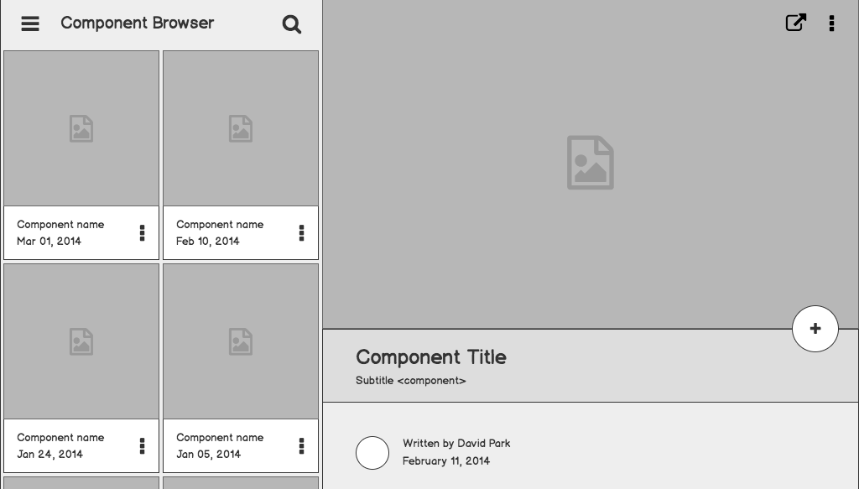
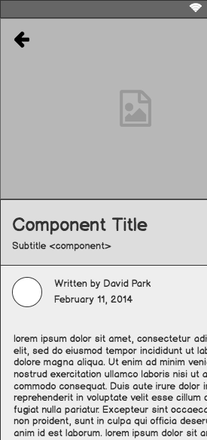
Network Device Monitoring & Building Wide Connectivity
Dustin Cogan, IT Director
Justin Hayward- Assistant Director
Maquoketa Community Schools- Iowa

Slide 2
Outline
Why Network Monitoring Is Essential?
Demonstration of existing network options
Demonstration of setup
Partner Vendor For This Product (Special for Brainstorm Only)
Questions

Slide 3
Why is Network Monitoring Essential?
Today’s Network Demands
SIS
VOIP
Security Cameras
Door Access Systems
Time Clocks
Digital Signage
PA Systems
State Testing
Internet
Fire Systems/ Alarm Systems
Others
Yesterday’s Demands
SIS
Internet
VS
The networking demands in today’s schools are far greater than they have ever been.
I do not see this slowing down any time soon, but instead increasing in the foreseeable future.

Slide 4
Problem statement
How Do you Know Closet/Uplink/Downlink Bandwidth Utilization?
How do you know if you should erate for additional bandwidth?
How do you plan network connections beyond one year?
----------
Important Thought: Purchase enough bandwidth to sustain and expand programs while keeping budget sustainability in mind and the impact to the overall picture
----------

Slide 5
What is Intermapper?

Slide 6
How am I
notified?

Slide 7
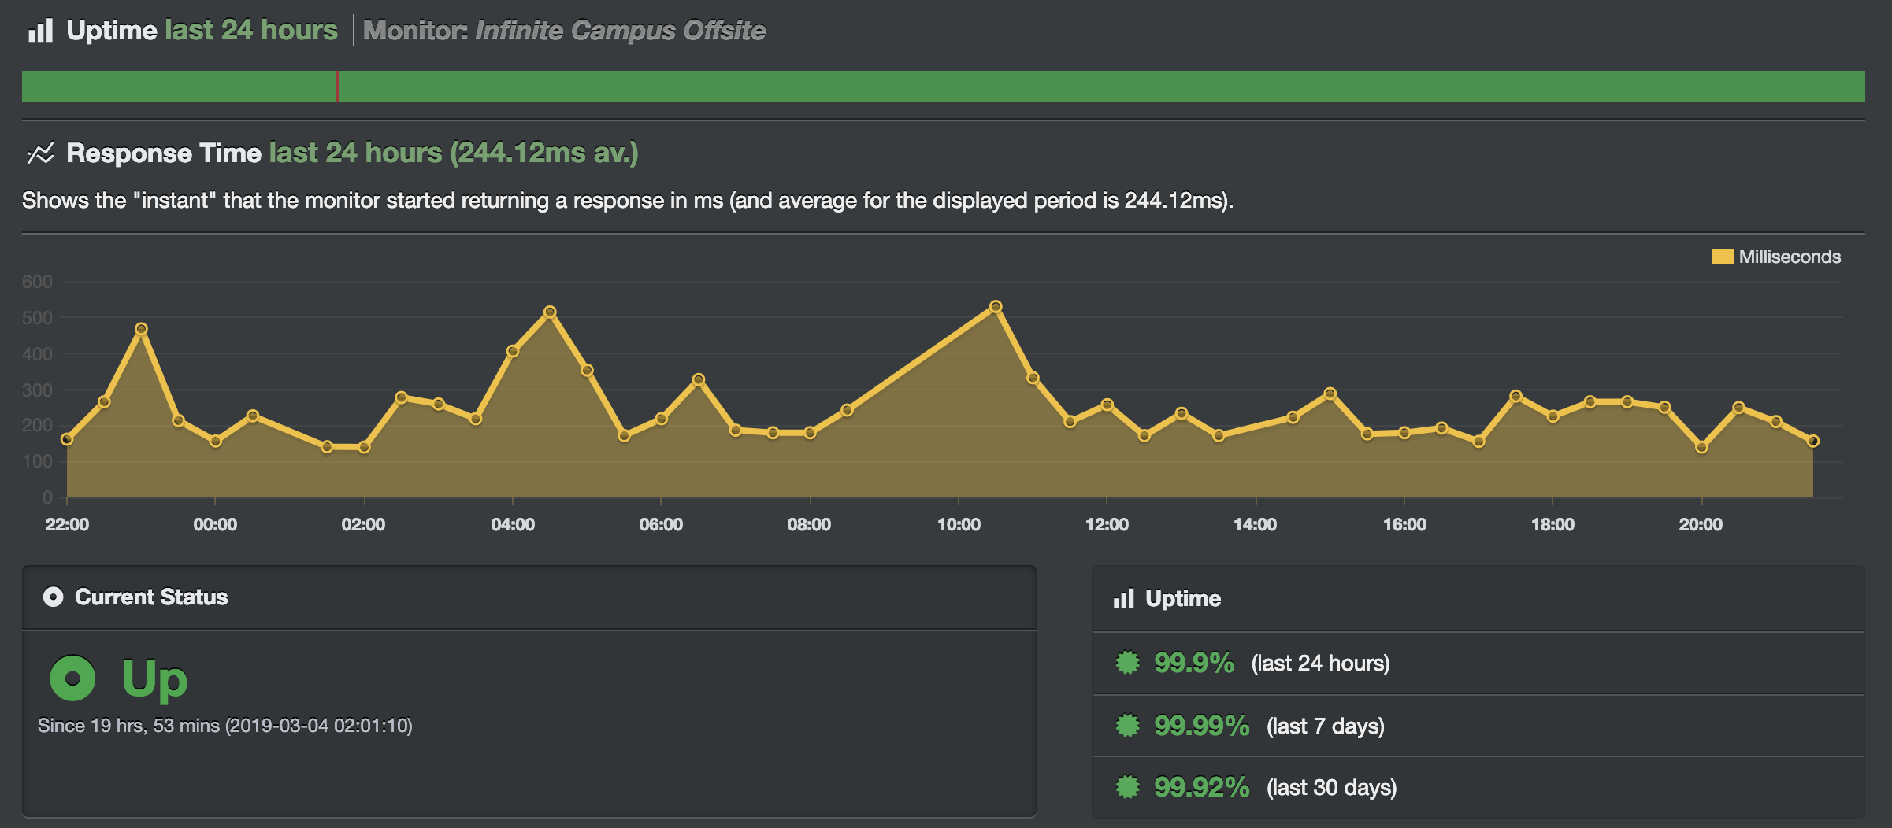
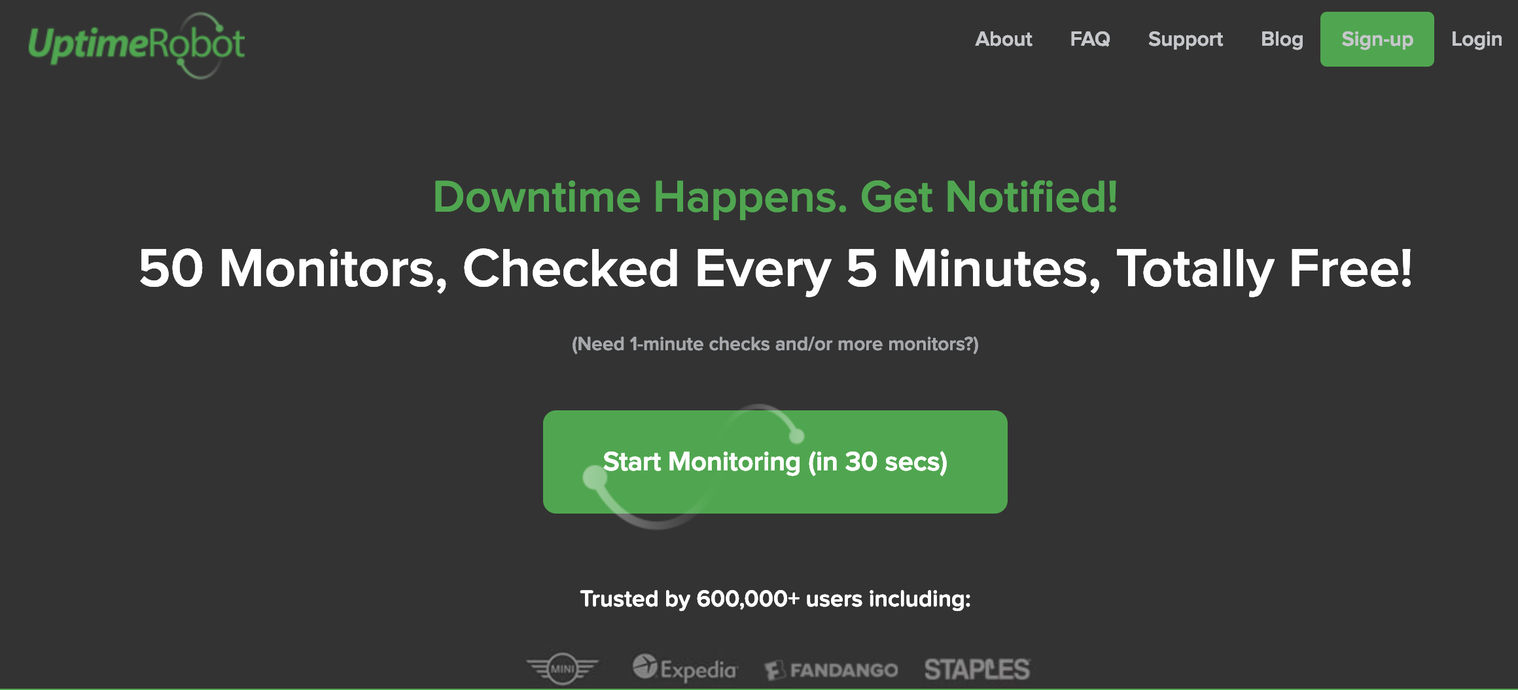
Monitoring is Necessary Also From Outside Your Network Looking In…...

Slide 8
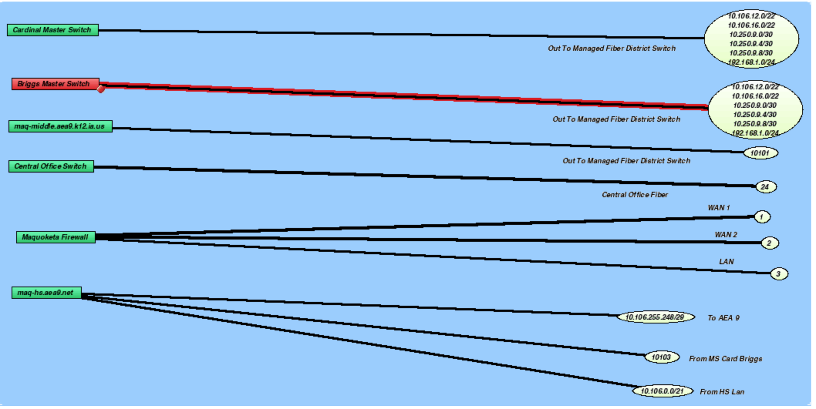

Slide 9
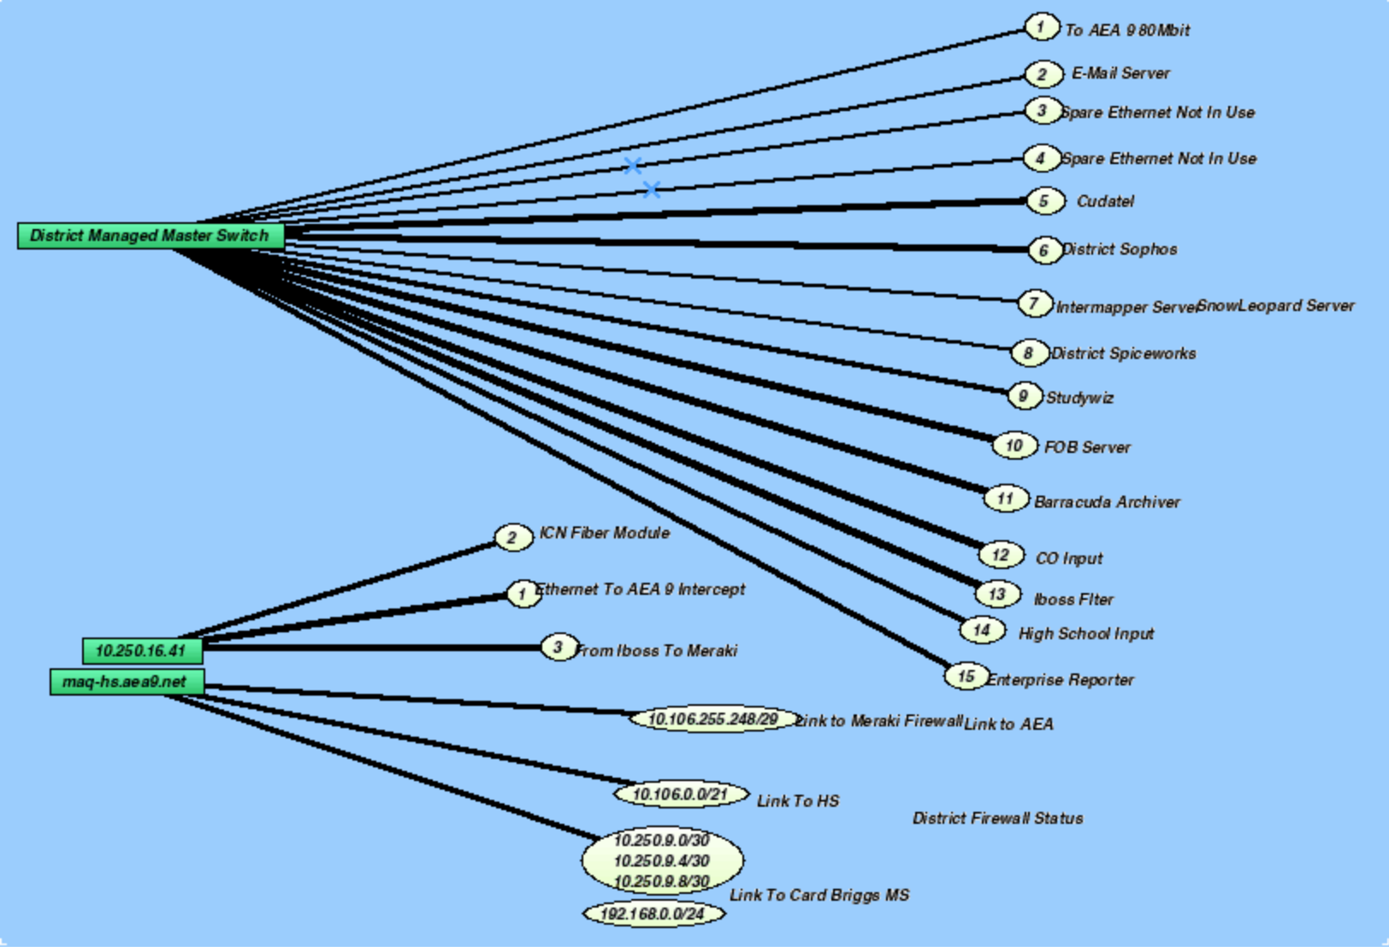

Slide 10
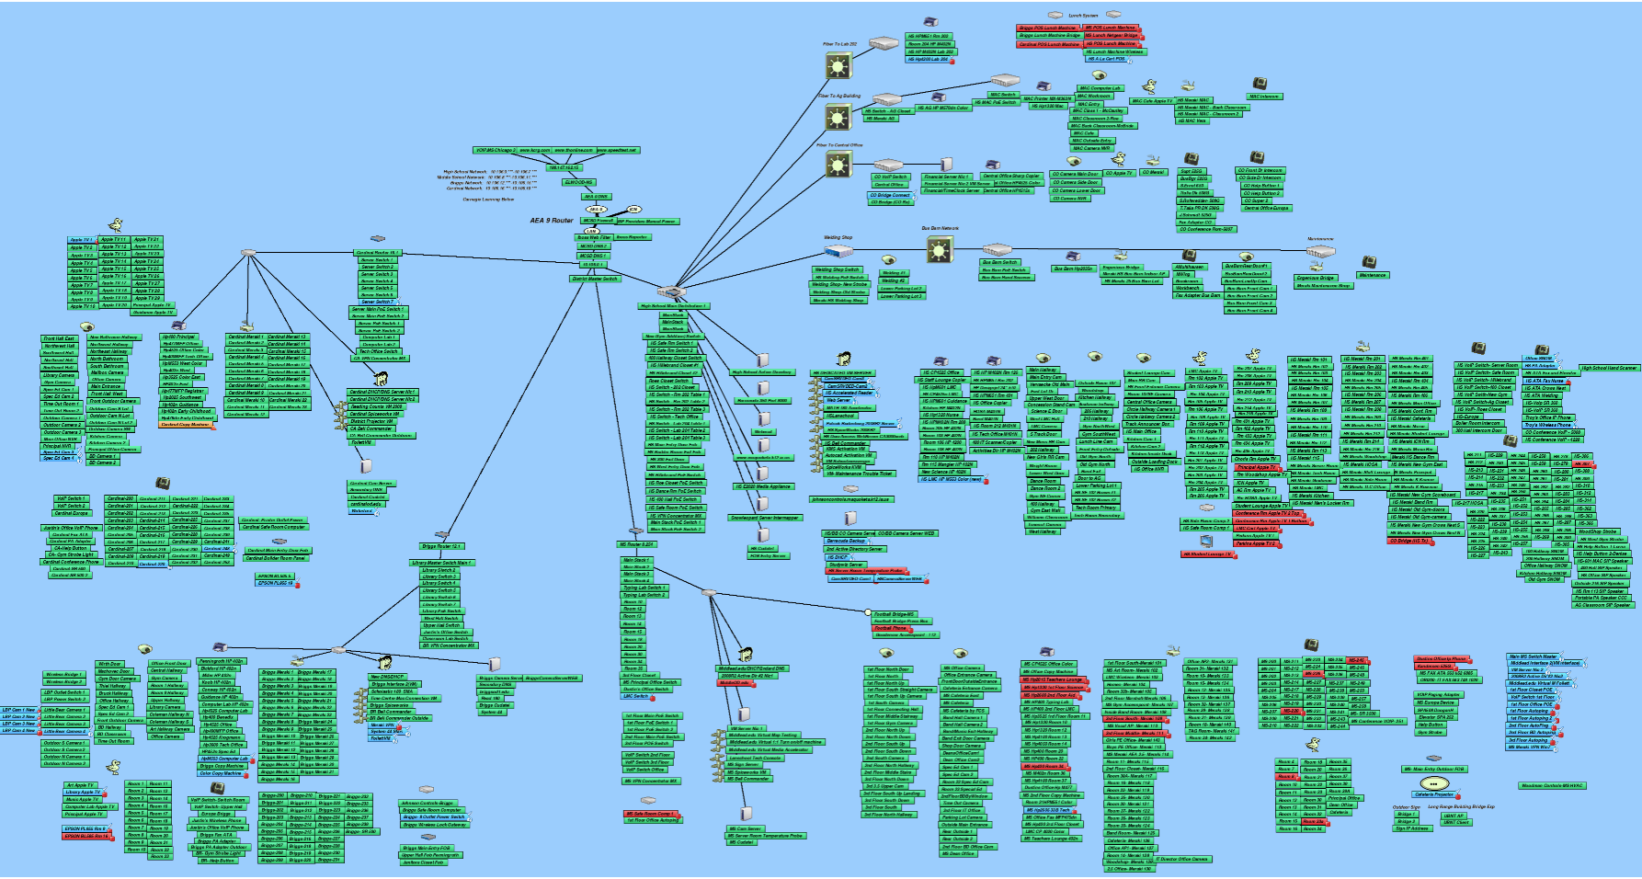

Slide 11
Preferred Vendor:
“Exclusive Pricing Brainstorm Special”
20-25% Off
SHI International
-Victoria Pelosi- Booth-
• 25 devices - $550 + $215 annual Support & Maintenance
• 50 devices - $1,075 + $215 annual Support & Maintenance
• 100 devices - $1,965 + 20% annual Support & Maintenance
• For larger device counts, please advise

